Slide 1
ANSI SQL
Joins and Their Types
1

Slide 2
Overview
The session provides knowledge and understanding of Joins and Their Types in SQL
2

Slide 3
Enabling Objectives
At the end of this session, in the next 90 minutes you will be able to:
Retrieve Data from Multiple Tables by Writing SELECT statements to
Access data from more than one table using Equi joins and Natural join.
Join a table to itself by using Self join
View data that generally does not meet a join condition by using Outer joins

Slide 4
Key Topics
Joins and its Types
Cross Join
Inner Join
Outer Join
Self-Join

Slide 5
Scenario
For the complete understanding of ANSI SQL, we are going to make use of Product Management System (PMS) for ABC Traders.
ABC Traders is a company which buys collectable model cars, trains, trucks, buses, and ships directly from manufacturers and sell them to distributors across the globe. In order to manage the stocking, supply, and payment transactions, the above mentioned software is developed.
As per the requirement of the trading company, an inventory system is developed to collect the information of the products, customers, and their payment processing.
4

Slide 6
Database Tables
There are many entities involved in Product Management System.
We will be dealing with PMS throughout this session.
Offices
To maintain information of offices, for example, office code, address, city, and so on.
Customer
To maintain customer details, for example, customer name, address, and so on.
Employees
To maintain employee
details, for example, ID,
name, and so on.
Products
To maintain information of products, for example, product id, name, and so on.
Payments
To maintain information of payments done, for example, payment date, amount, and so on.
Orders
To maintain Orders done by customers, for example, order no, date, and so on.
Order Details
To maintain Orders done by customers, for example, order no, date, and so on.

Slide 7
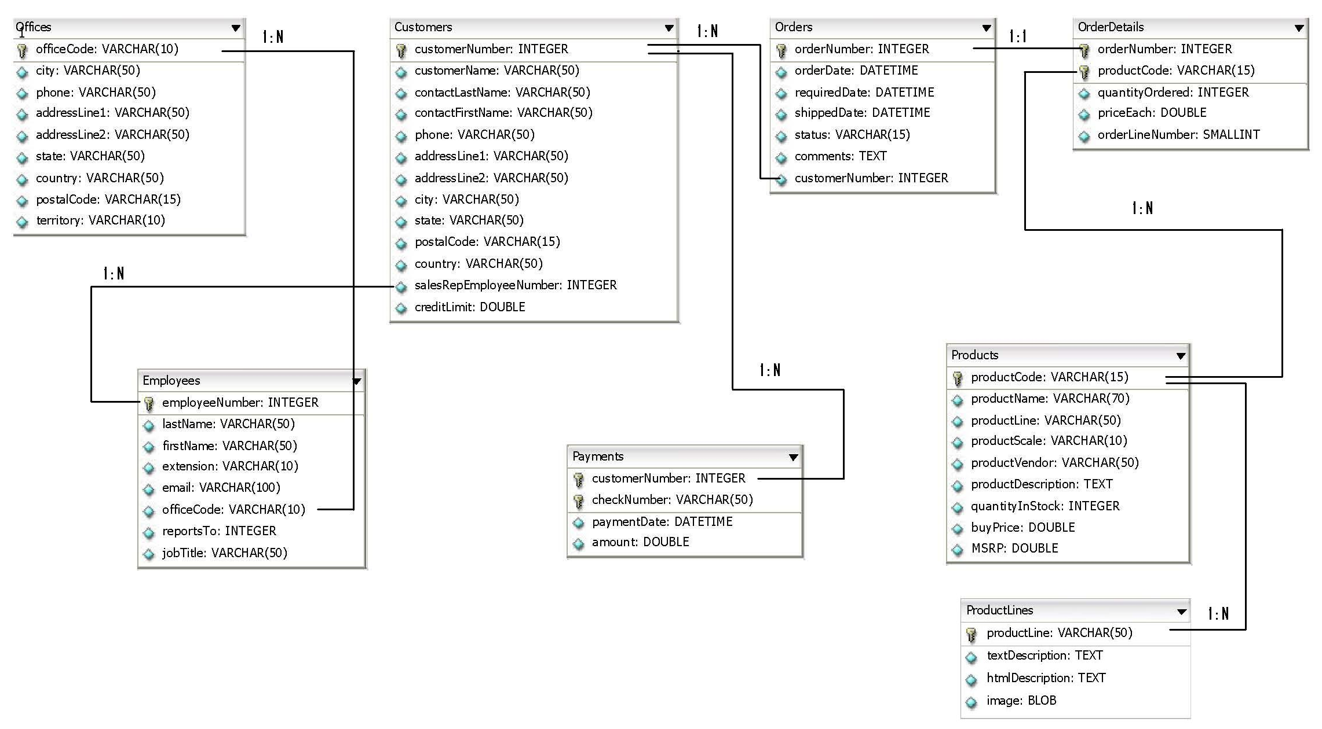
Schema Diagram
6

Slide 8
Joins and its types

Slide 9
Why Join
SQL JOINS are used to query data from two or more tables, based on a relationship between certain columns in these tables.
Using JOINS, you can fetch exactly the data you want
from any number of tables with just one query
using any search parameter you chose to filter the results.
Different vendors allow varying numbers of tables to join in a single join operation.
For example:
Oracle is unlimited in the number of allowable JOINS
Microsoft SQL Server allows up to 256 tables in a join operation

Slide 10
JOINS Style
Which JOIN Style can be used?
SQL JOINS can be written using any of the two styles mentioned below:
Theta Style
ANSI Style (Preferred by Industry)

Slide 11
Theta Style
In non-ANSI standard implementation,
the join operation is performed in the WHERE clause in the query.
This join method is known as the theta style.
In the FROM clause, tables are listed as if with Cartesian products.
The WHERE clause specifies how the join should take place.
This is considered to be the "old" style, and confusing to read.

Slide 12
Theta Style
Syntax:
SELECT <ColumnName1>,<ColumnName2>,<ColumnNameN>
FROM <TableName1>,<TableName2>
WHERE <TableName1>.<ColumnName1>=<TableName2>.<ColumnName2>
AND <Condition>
ORDER BY <ColumnName1>,<ColumnName2>,<ColumnNameN>
ColumnName1 in TableName1 is usually that table's Primary Key
ColumnName2 in TableName2 is a Foreign Key in that table
ColumnName1 and ColumnName2 must have the same data type and for certain data types, the same size

Slide 13
ANSI Style
In the ANSI SQL-92 standards,
joins are performed by incorporating JOIN clause in the query.
This join method is known as ANSI style.
Syntax:
SELECT <ColumnName1>,<ColumnName2>,<ColumnNameN>
FROM <TableName1><JOIN TYPE><TableName2>
ON <TableName1>.<ColumnName1>=<TableName2>.<ColumnName2>
WHERE <Condition>
ORDER BY <ColumnName1>,<ColumnName2>,<ColumnNameN>

Slide 14
ANSI Style
Joins in the ANSI style are more readable than those in Theta style
Query itself clearly indicates, which table is on the left in a LEFT JOIN and right in a RIGHT JOIN.
There are two variations of ANSI Style as
JOIN ... ON (preferred by industry)
JOIN … USING which will be covered in the next example.

Slide 15
JOIN ... ON
With JOIN ... ON, one separates the join terms from the filtering terms.
Example:
SELECT o.city, o.country, e.jobtitle
FROM offices o INNER JOIN employees e
ON (o.officecode = e.officecode)
WHERE o.country LIKE ‘%USA%’;
It is quite clear now what belongs to what.
Note: The parenthesis is not strictly required in the ON clause
Notes:
Note: The parenthesis is not strictly required in the ON clause

Slide 16
JOIN ... USING
ANSI Style: JOIN ... USING
It is the special case where we join tables on columns of the same name. We can make a shortcut and use USING.
Rewriting the previous example:
SELECT o.city, o.country, e.jobtitle
FROM offices o INNER JOIN employees e
USING (officecode)
WHERE o.country LIKE ‘%USA%’;
This time the parenthesis is required.
Note: This ANSI syntax is supported only by: MySQL, Oracle, and DB2 databases.

Slide 17
Types of Joins
Joins
Cross Join
Inner Join
Outer join
Self join
It will produce rows which combine each row from the first table with each row of the second.
Returns all rows from one table and only those rows from a secondary table where the join condition is met.
(simple join): join of two or more tables that returns only those rows that satisfy the join condition.
Join of a table to itself.
Notes:
We will be looking at the following types of JOINS which are supported by almost all database vendors in market
ANSI standard SQL specifies four types of JOINS: INNER, OUTER, LEFT, and RIGHT.

Slide 18
Cross Join

Slide 19
CROSS JOIN
Returns the Cartesian product of rows from tables in the join.
It will produce rows which combine each row from the first table with each row of the second.
Can be used in situations where the various combinations of two or more table records are needed.
Does not apply any predicate to filter records from the joined table.
Programmers can further filter the results of a cross join by using a WHERE clause.

Slide 20
CROSS JOIN
Example:
SELECT o.country, e.jobtitle
FROM offices o CROSS JOIN employees e;
Explanation:
If two tables t1 and t2 having columns p and r, rows n and m, respectively, are exhibiting
CROSS JOIN, then the result of query will produce p+r columns and n*m tuples.

Slide 21
Inner Join

Slide 22
INNER JOIN
Is the default join-type.
Creates a new result table by combining column values of two tables (A and B) based upon the join-predicate.
The query compares each row of A with each row of B to find all pairs of rows which satisfy the join-predicate.
When the join-predicate is satisfied, column values for each matched pair of rows of A and B are combined into a result row.
Notes:
The result of the join can be defined as the outcome of first taking the Cartesian product (or Cross join) of all records in the tables (combining every record in table A with every record in table B)—then return all records which satisfy the join predicate.

Slide 23
INNER JOIN
ANSI Style:
SELECT o.city, o.country, e.jobtitle
FROM offices o INNER JOIN employees e
ON o.officecode = e.officecode;
Joins the offices and employees tables using the officecode column of both tables.
Returns all rows from the offices and employees tables where there is a matching officecode value in both the tables.
If the officecode does not match, no result row is generated.

Slide 24
Classification of Inner joins
Inner Join
Equi Join
Natural Join
Join with a join condition containing an equality operator.
join predicate arises implicitly by comparing all columns in both tables that have the same column-names in the joined tables.

Slide 25
EQUI-JOIN
Is a specific type of comparator-based join
uses only equality (=) comparisons in the join-predicate.
Using other comparison operators (such as <,>,<=,>=) disqualifies a join as an EQUI-JOIN.
ANSI Style:
SELECT o.city, o.country, e.jobtitle
FROM offices o INNER JOIN employees e
ON o.officecode = e.officecode;

Slide 26
NATURAL JOIN
Is a type of EQUI-JOIN
Join predicate arises implicitly by comparing all columns in both tables that have the same column-names in the joined tables.
The resulting joined table contains only one column for each pair of similarly named columns.

Slide 27
NATURAL JOIN
Disadvantages:
NATURAL joins are dangerous.
The danger comes from inadvertently adding a new column, named the same as another column in the other table.
and therefore strongly discourage their use.
Existing NATURAL join may use the new column for comparison with different criteria than before.
Thus an existing query could produce different results, even without any change in data.
Notes:
An existing NATURAL JOIN might then "naturally" use the new column for comparisons, making comparisons or matches using different criteria (from different columns) than before.
Thus an existing query could produce different results, even though the data in the tables have not been changed, but only augmented.

Slide 28
NATURAL JOIN
ANSI Style:
SELECT * FROM orders NATURAL JOIN orderdetails;
As with the explicit USING clause, only one ordernumber column occurs in the joined table, without qualifier table name.
Notes:
Rule:
In case of USING clause and NATURAL JOIN, only one copy of join key column occurs
as the result, with no qualifier.

Slide 29
Outer Join

Slide 30
OUTER JOIN
An OUTER JOIN does not require each record in the two joined tables to have a matching record.
The joined table retains each record—even if no other matching record exists.
No implicit join-notation for OUTER JOINS

Slide 31
OUTER JOIN
Depending on the table's rows that are retained,
OUTER join is further divided into:
LEFT OUTER JOIN or LEFT JOIN
RIGHT OUTER JOIN or RIGHT JOIN
FULL OUTER JOIN
Use either LEFT /RIGHT/FULL, just OUTER JOIN will not work.
In this case left and right refer to the two sides of the JOIN keyword.

Slide 32
LEFT OUTER JOIN
In this join all rows from table specified on the left side of the join statement will appear.
When no matching data is found from the table on the right side of the join, nulls are placed into fields.
ANSI Style:
SELECT c.city, p.checknumber, p.amount
FROM customers c LEFT OUTER JOIN payments p
ON c.customernumber=p.customernumber;
All the rows of customers table will be fetched even if a matching row is not found in payments table

Slide 33
RIGHT OUTER JOIN
In this join all rows from table specified on the right side of join statement will appear.
When no matching data is found from the table on the left side of the join, nulls are placed into fields.
ANSI Style:
SELECT c.city, p.checknumber, p.amount
FROM customers c RIGHT OUTER JOIN payments p
ON c.customernumber = p.customernumber;
All the rows of payments table will be fetched even if a matching row is not found in customers table
Notes:
A RIGHT OUTER JOIN (or right join) closely resembles a LEFT OUTER JOIN, except with the treatment of the tables reversed.
Every row from the "right" table (B) will appear in the joined table at least once.
If no matching row from the "left" table (A) exists, NULL will appear in columns from A for those records that have no match in B.
A RIGHT OUTER JOIN returns all the values from the right table and matched values from the left table (NULL in case of no matching join predicate).

Slide 34
FULL OUTER JOIN
In this join, all the rows are returned from
table left to the join condition and
table right to the join condition
Supported: Microsoft SQL Server, DB2, Oracle 10g, 11g
Not Supported: MySQL, Sybase
ANSI Style:
SELECT c.city, p.checknumber, p.amount
FROM customers c FULL OUTER JOIN payments p
ON c.customernumber = p.customernumber;
Notes:
Conceptually, a FULL OUTER JOIN combines the effect of applying both LEFT and RIGHT OUTER JOINS.
Where records in the FULL OUTER JOINed tables do not match, the result set will have NULL values for every column of the table that lacks a matching row
For those records that do match, a single row will be produced in the result set (containing fields populated from both tables)

Slide 35
FULL OUTER JOIN
Some database systems do not support the FULL OUTER JOIN functionality.
Hence we can emulate it through the use of an INNER JOIN.
UNION ALL selects the "single table rows" from left and right tables respectively.
Example:
SELECT c.city, p.checknumber, p. amount FROM customers c
LEFT JOIN payments p ON c.customernumber = p.customernumber
UNION
SELECT c.city, p.checknumber, p. amount FROM customers c
RIGHT JOIN payments p ON c.customernumber=p.customernumber;

Slide 36
Self Join

Slide 37
SELF JOIN
Self join is used in situations where one row of a table is compared to another row of the same table.
The table, on which the self join will be used, appears twice in the From clause
Use table aliases to qualify column names in the join condition.
ANSI Style:
SELECT a.lastname, a.reportsto, b.firstname, b.reportsto, b.jobtitle
FROM employees a INNER JOIN employees b
ON a.jobtitle =b.jobtitle;
Notes:
A SELF JOIN is joining a table to itself.
Use a SELF JOIN when you want to create a result set that joins records in a table with other records in the same table.
To list a table two times in the same query, you must provide a table alias for at least one of instance of the table name.
This table alias helps the query processor to determine whether columns should present data from the right or left version of the table.

Slide 38
Lend a Hand
Refer RIO_07_ANSI_SQL_Joins_and_Their_Types - Lend a Hand.ppt document file

Slide 39
Test your Understanding
What are the advantages of Joins?
How to retrieve only the matching rows from two tables?
How Outer Join is different from Inner Join?
When to use Self Join?

Slide 40
Recap
The key points covered in this chapter are:
SQL JOINS are used to query data from two or more tables, based on a relationship between certain columns in these tables.
JOINS are of two types:
Theta Style and ANSI style
CROSS JOIN returns the Cartesian product of rows from tables in the join
Inner join creates a new result table by combining column values of two tables (A and B) based upon the join-predicate
The details of Outer JOIN, CROSS JOIN, LEFT OUTER JOIN, RIGHT OUTER JOIN, FULL OUTER JOIN, and SELF JOIN.

Slide 41

Source
Website:
http://en.wikipedia.org/wiki/Join_(SQL)
Books:
O’Reilly SQL In NutShell Page No: 37, 144, 145, 146
Oracle for Professionals - Covers Oracle 9i, 10g and 11g W CD By Sharanam Shah, Vaishali Shah Page no:451
Disclaimer: Parts of the content of this course is based on the materials available from the Web sites and books listed above. The materials that can be accessed from linked sites are not maintained by Cognizant Academy and we are not responsible for the contents thereof. All trademarks, service marks, and trade names in this course are the marks of the respective owner(s).

Slide 42
You have successfully completed -
ANSI SQL Joins and Their Types
42

